Slide 1
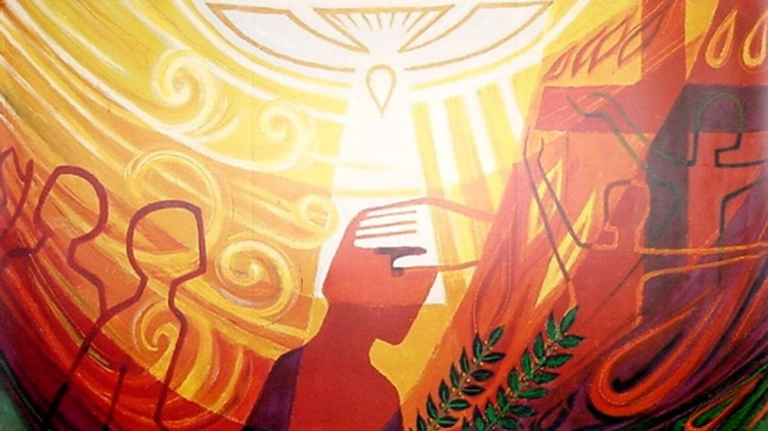
May 9
Mass with Confirmation Candidates
-1

Slide 2
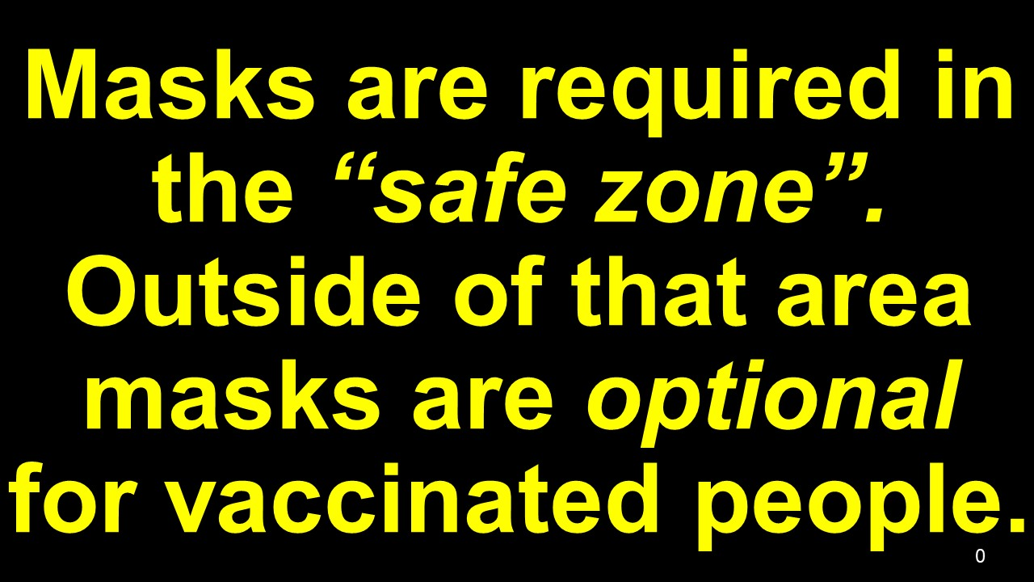
0

Slide 4
Come, Lord Jesus, send us your Spirit.
Renew the face
of the earth.

Slide 5
Blessed be God!
O Blessed be God!
--------------------------------------------------------------------------------------------------------------------------------------
Who calls you by name!
-----------------------------------------------------------------------------------------------------------------------------------+++
Holy and chosen one!

Slide 6
2

Slide 7
By our loving service and works of mercy
we invite every person to know
Jesus Christ,

Slide 8
present in the Word and the Breaking
of the Bread,
so that all may accept his gift of salvation.

Slide 9
66

Slide 10
Come, Lord Jesus, send us your Spirit.
Renew the face
of the earth.
B

Slide 11
4a

Slide 12
God of Mercy and Love, help us to
open our hearts to
the healing presence
of your Holy Spirit.

Slide 13
Guide us, your disciples, to fulfill your dreams for us and all of creation.

Slide 14
We ask this in the name our Risen Lord, Jesus, the Christ.
Amen.

Slide 15
5

Slide 16
Blessed be God!
O Blessed be God!
--------------------------------------------------------------------------------------------------------------------------------------
Who calls you by name!
--------------------------------------------------------------------------------------------------------------------------------------
Holy and chosen one!

Slide 18
……Everyday God,
…………...O Jesus,
……………O Spirit,
..Come, be with us.

