Slide 1
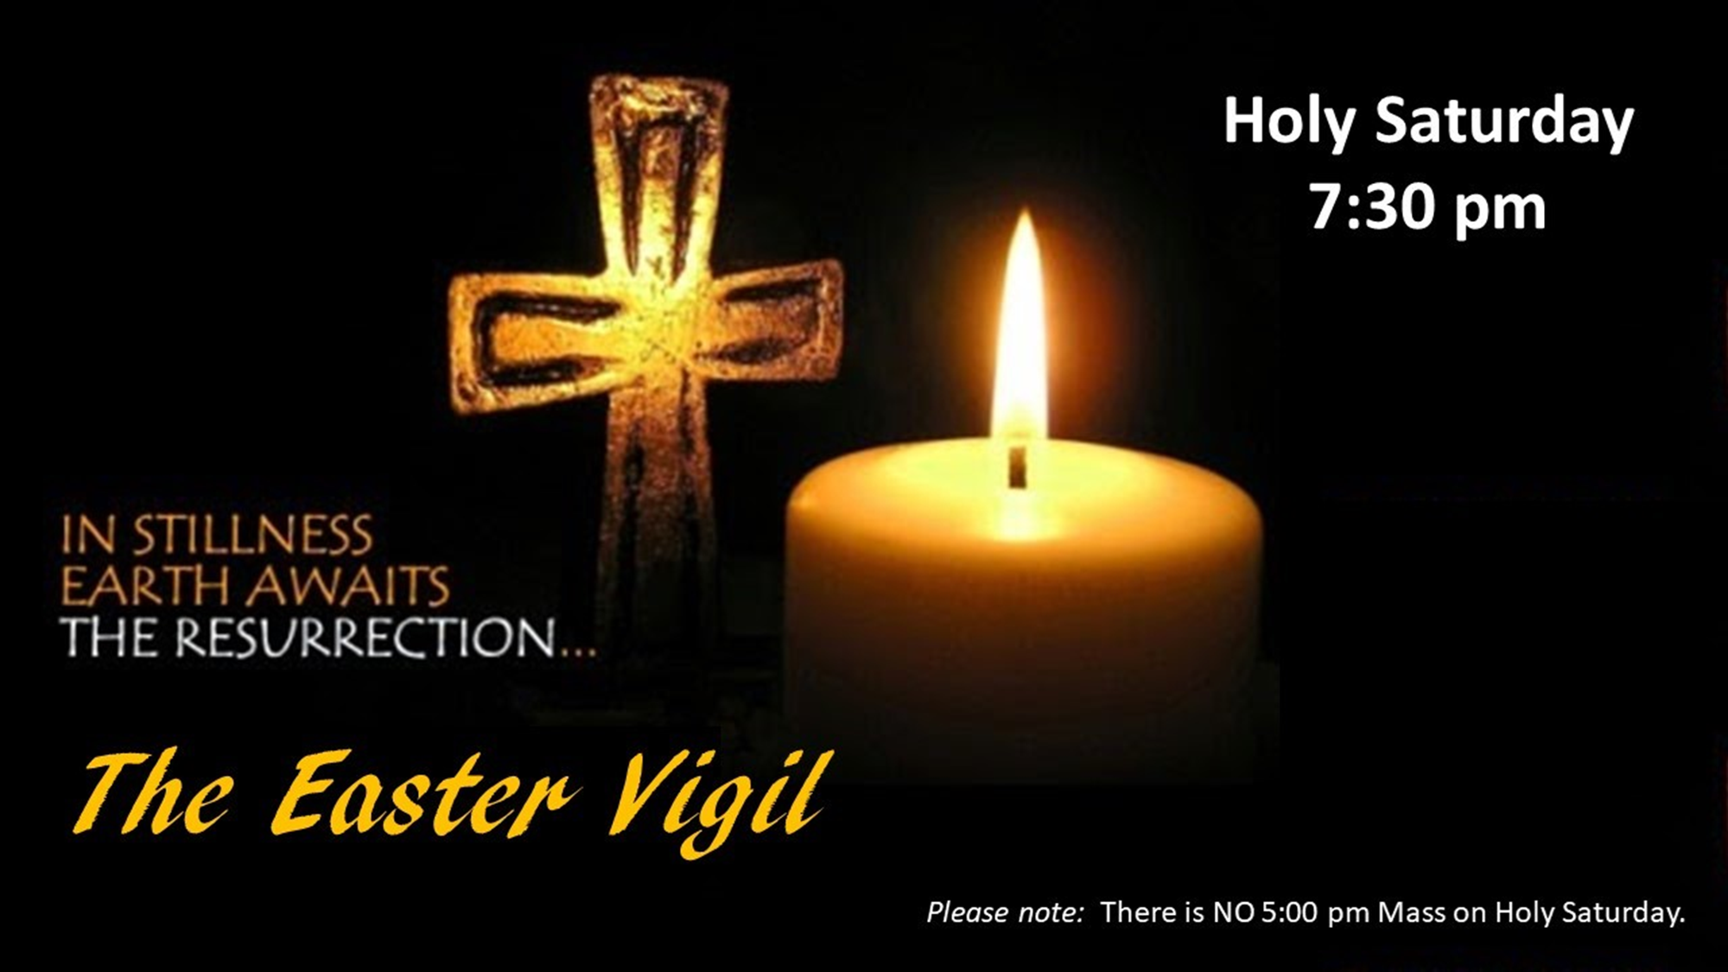
-1

Slide 2
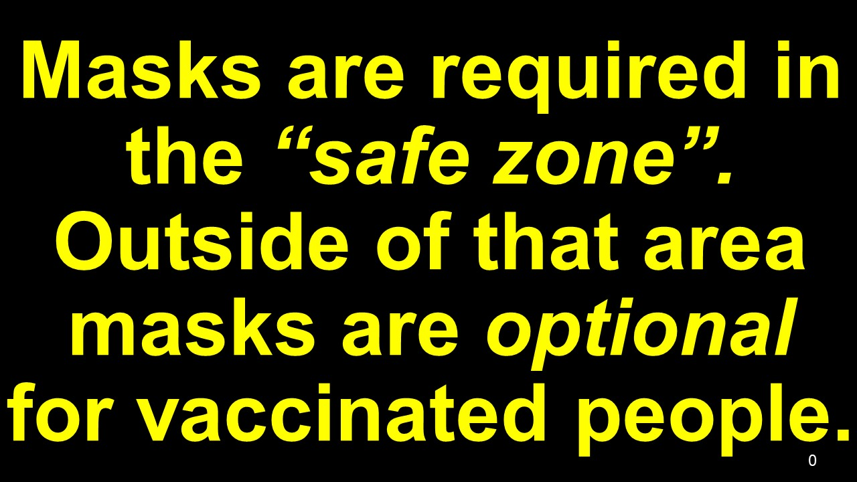
0

Slide 4
Surrexit Christus,
Alleluia!
Cantate Domino,
Alleluia!
B

Slide 5
4a

Slide 6
God of Mercy and Love, help us to
open our hearts to
the healing presence
of your Holy Spirit.

Slide 7
Guide us, your disciples, to fulfill your dreams for us and all of creation.

Slide 8
We ask this in the name our Risen Lord, Jesus, the Christ.
Amen.

Slide 9
5

