Slide 1
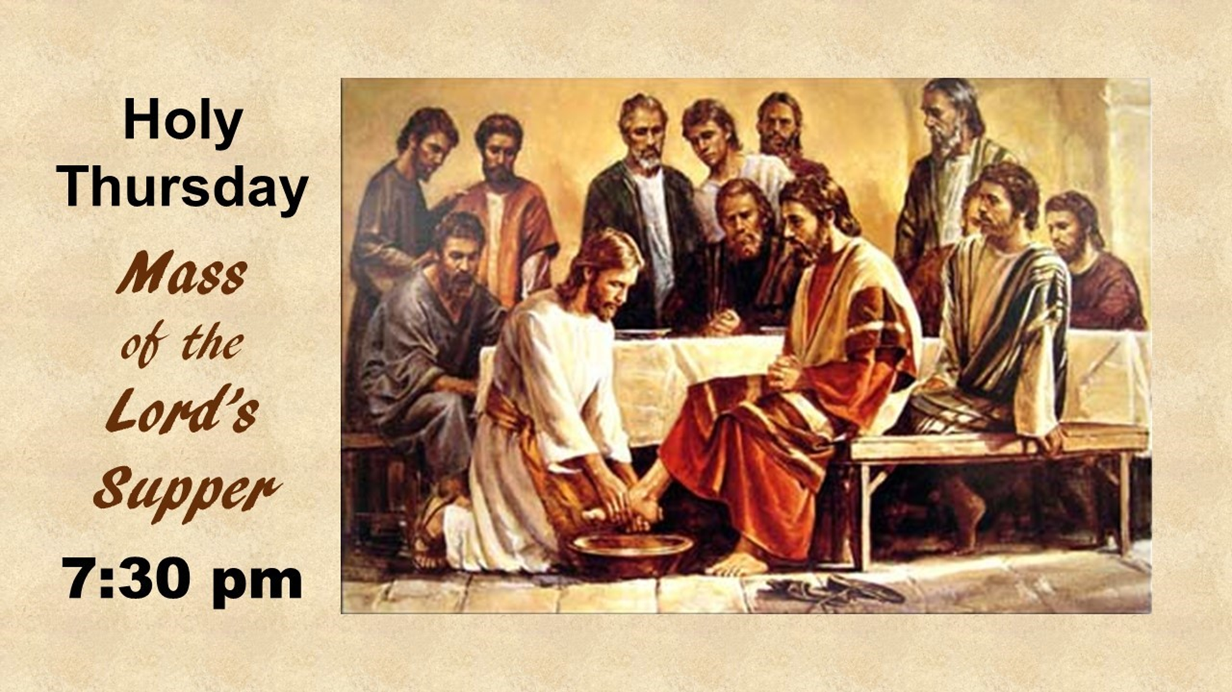
-1

Slide 2

0

Slide 4
El cáliz que bendecimos
es la comunión
de la sangre de Cristo.
Our blessing cup
is a communion with the Blood of Christ.

Slide 5
2

Slide 6
By our loving service and works of mercy
we invite every person to know
Jesus Christ,

Slide 7
present in the Word and the Breaking
of the Bread,
so that all may accept his gift of salvation.

Slide 8
66

Slide 9
El cáliz que bendecimos
es la comunión
de la sangre de Cristo.
Our blessing cup
is a communion with the Blood of Christ.
B

Slide 10
4a

Slide 11
Glory, praise,
and honor to you,
Lord, Jesus Christ.
8

Slide 12
4

Slide 13
God of Mercy and Love, help us to
open our hearts to
the healing presence
of your Holy Spirit.

Slide 14
Guide us, your disciples, to fulfill your dreams for us and all of creation.

Slide 15
We ask this in the name our Risen Lord, Jesus, the Christ.
Amen.

Slide 16
5

